Slide 1
Driver Station
MVRT
2009 – 2010 Season

Slide 2
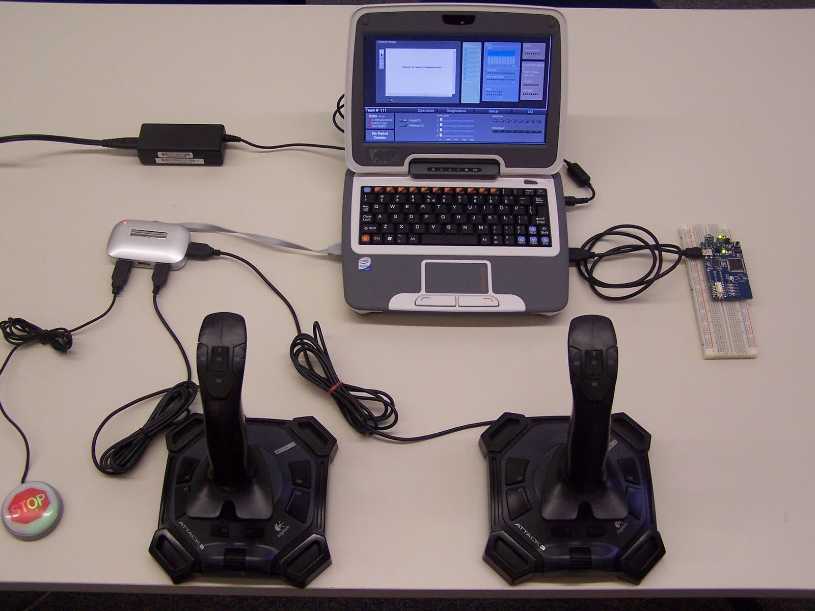
Add information
Classmate PC
USB Hub
Breadboard
Joysticks
Stop Button

Slide 3
Classmate PC
Classmate PC
Accounts
Developer – Like regular PC Account
Administrator
Driver
Driver Station software can be installed on other computers
2 USB ports
1 Ethernet
16 gigabyte hard drive
Downsides:
Very small key size – making it very difficult to code
Relatively slow
Advantages:
First provides a charger during the match for the classmate during competition (as of 2010-11 season)

Slide 4
Stop Button
Connected by the USB hub to the computer
Acts as an Emergency Stop button
In general the program can not be run without connecting the stop button
Although you can bypass this by switching to Diagnostics tab, double-clicking on the red LED labeled Stop Button, and acknowledging the message
Press Ctrl-Alt-Enter
Have to reboot the cRio after pressing the stop button
Reboot Robot button no longer works after Stop button is pressed, so manual reboot is needed.
Sometimes it does not work when plugged into the USB hub

Slide 5
Cypress FirstTouch
PSoC 3
A board you can attach to a standard breadboard that allows you to use digital and analog devices with your driver station.
Need to install PSoC programmer in order to install the firmware on the board
Need to both install firmware (a hex file) onto the board and a USB interface image for Labview in order to get the FirstTouch running.
Only Digital and Analog Pins work with the Dashboard, other functions such as the accelerometer are disabled.

Slide 6
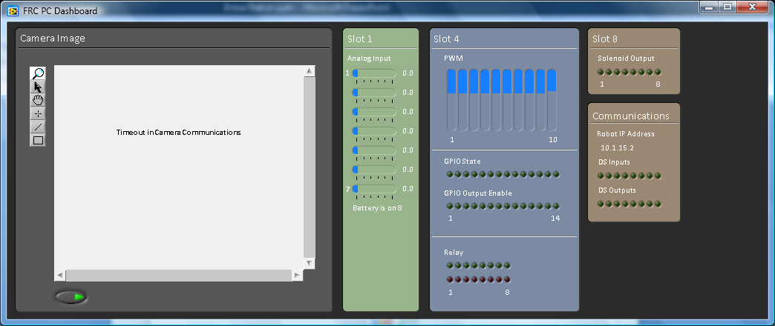
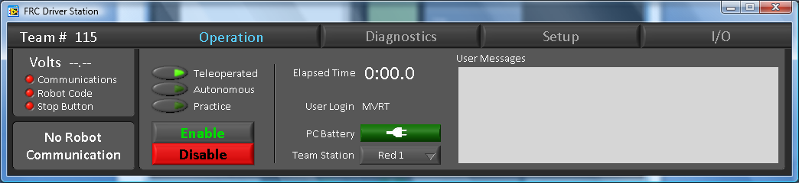
Driver station

Slide 7
Dashboard
Shows the camera output
Shows the communication with some of the inputs and outputs including the solenoid, PWM

Slide 8
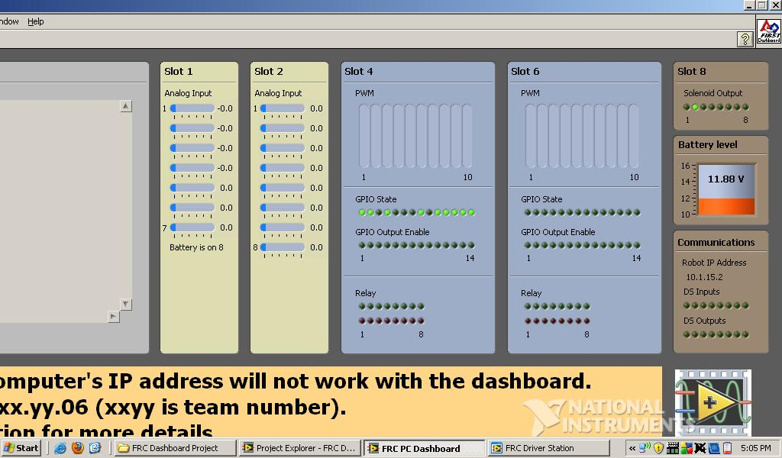
Dashboard Customizing
Able to customize dashboard by editing the dashboard project

Slide 9
Operations Tab
Shows the battery's volts on the robot
Shows communication with the robot
Shows whether code uploaded
Shows whether stop button is connected
Able to choose between teleoperated, autonomous and practice mode
Enable and disable buttons
Even if you are in a different window, the space bar will enable or disable the robot
Has elapsed time since you enabled the robot
Shows PC battery
Can choose which team you are (red or blue)

Slide 10
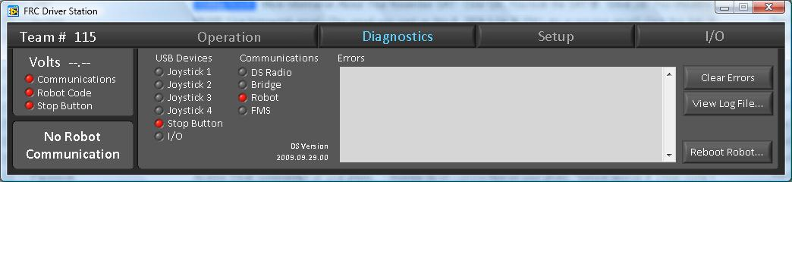
Diagnostics Tab
Shows a detailed report of the communication with each of the connected devices
Detailed error log
Helpful for debugging code
Button for rebooting the cRio

Slide 11
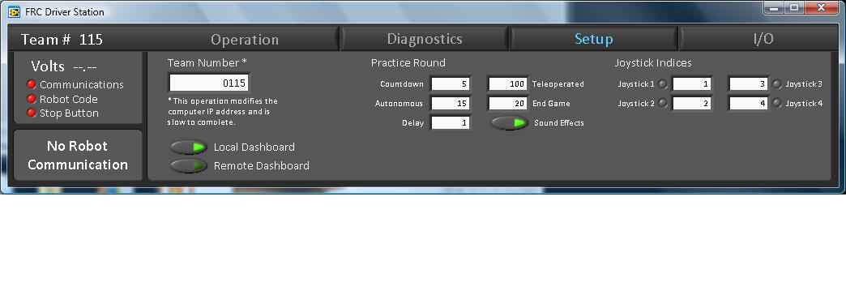
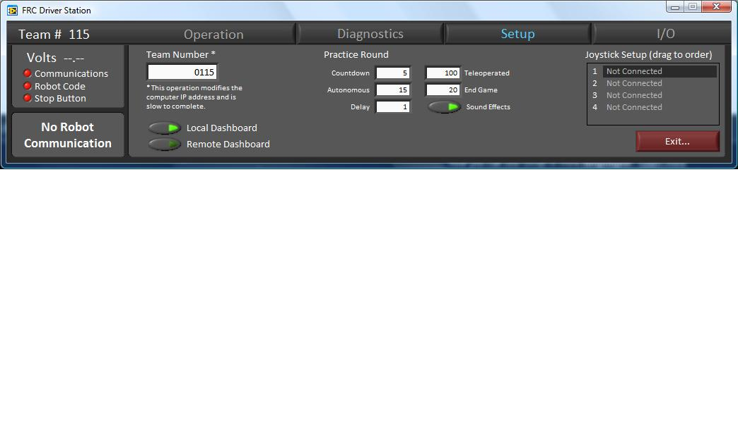
Setup Tab
Set team number
Sets IP address by itself
Allows you to set variables in a simulated match
Button to run practice match is in operation tab

Slide 12
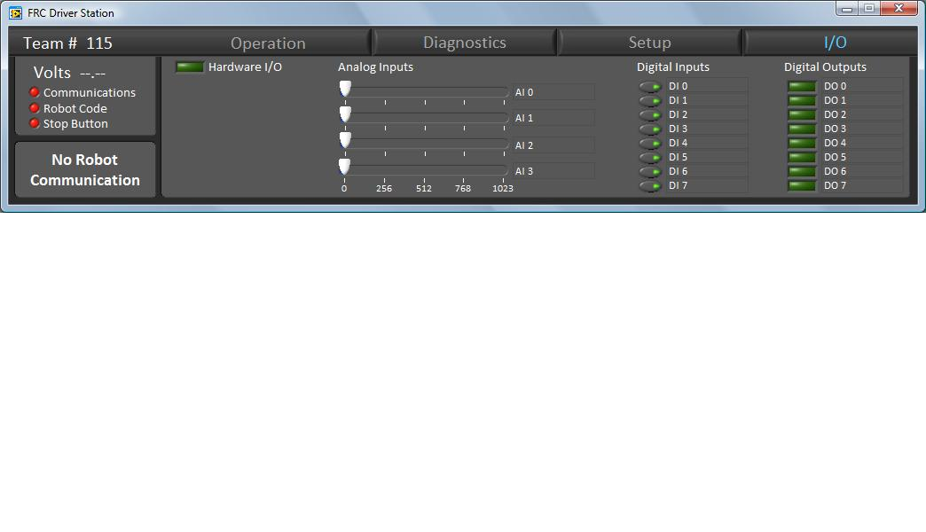
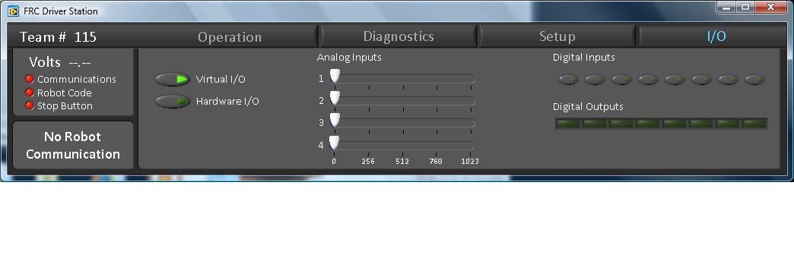
I/O Tab
Simulates digital inputs and outputs
Simulates analog inputs and outputs

Slide 13
Labview Changes 8.6
2009 – 2010 Season

Slide 14
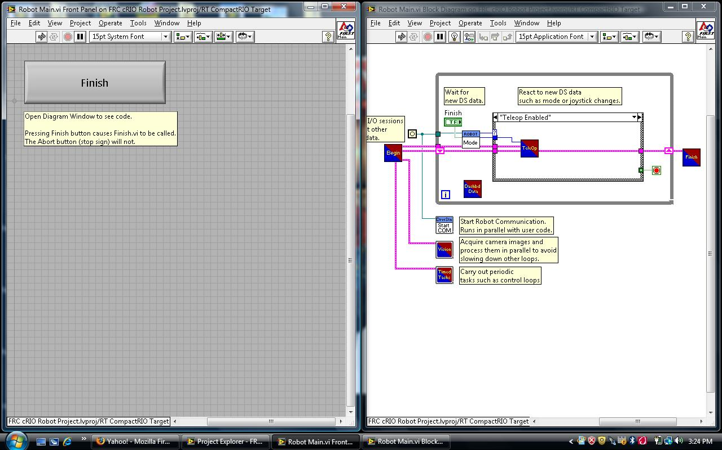
What is LabVIEW?
Graphical data flow language
Easy drag-and-drop functions
Used by scientists and engineers
Uses VI’s (Virtual Instruments), which comprise of a block diagram and a front panel, to manipulate data.

Slide 15
Changes in LabVIEW
Examples Update
Robot Framework
Global Variable Changes
Initializing global variables
Inputting global variables
SubVI Compatibility
LabVIEW diff
LabVIEW Clean up

Slide 16
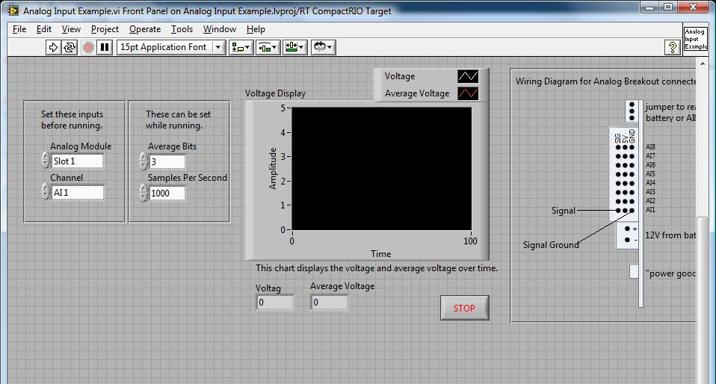
Examples Updated
Analog Input Example
The examples have directions on how to wire the device.

Slide 17
Robot Framework
LabVIEW 8.5 has Basic and Advanced frameworks when creating a new project
Now we only have one framework, which is similar to last year’s Advanced Framework

Slide 18
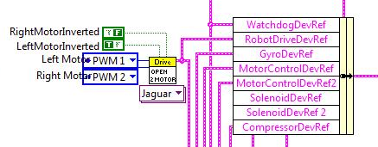
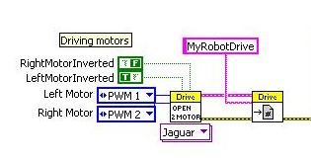
Initializing Global Variables
Old
New
DevRefs initialized
DevRefs grouped into a bundle
bundle goes to the global variable ‘Robot Data’
Advantages
Easier to keep track of where variables change
DevRefs initialized
DevRefs become global variables (becomes part of Refnum registry)
Advantages
neater and cleaner
easier

Slide 19
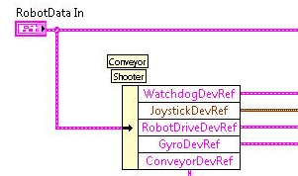
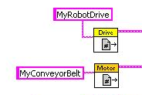
Inputting Global Variables
Old
New
input ‘Robot Data’
unbundled ‘Robot Data’ to access DevRefs
Advantages
Easier to keep track of where variables change
input global variables
Advantages
neater and cleaner
simpler

Slide 20
SubVI Compatibility
SubVIs made in LabVIEW 8.5 can not be used directly in LabVIEW 8.6
To use the 8.5 SubVIs
Open the old SubVI in LabVIEW 8.6
Save the SubVI as an 8.6 file
Make sure the DevRef names match
If you do not transfer the SubVIs correctly, it gives an error message while running

Slide 21
LabVIEW Diff

Slide 22
What is LabVIEW Diff
LabVIEW 8.6 includes a new feature for FRC teams called Diff
LabVIEW Diff allows us to compare two Vis and find out all the differences
This can be very useful in comparing LabVIEW 8.6 default code with LabVIEW 8.5 default code to see what has changed
It can also be used to see the differences between different versions of your own code.

Slide 23
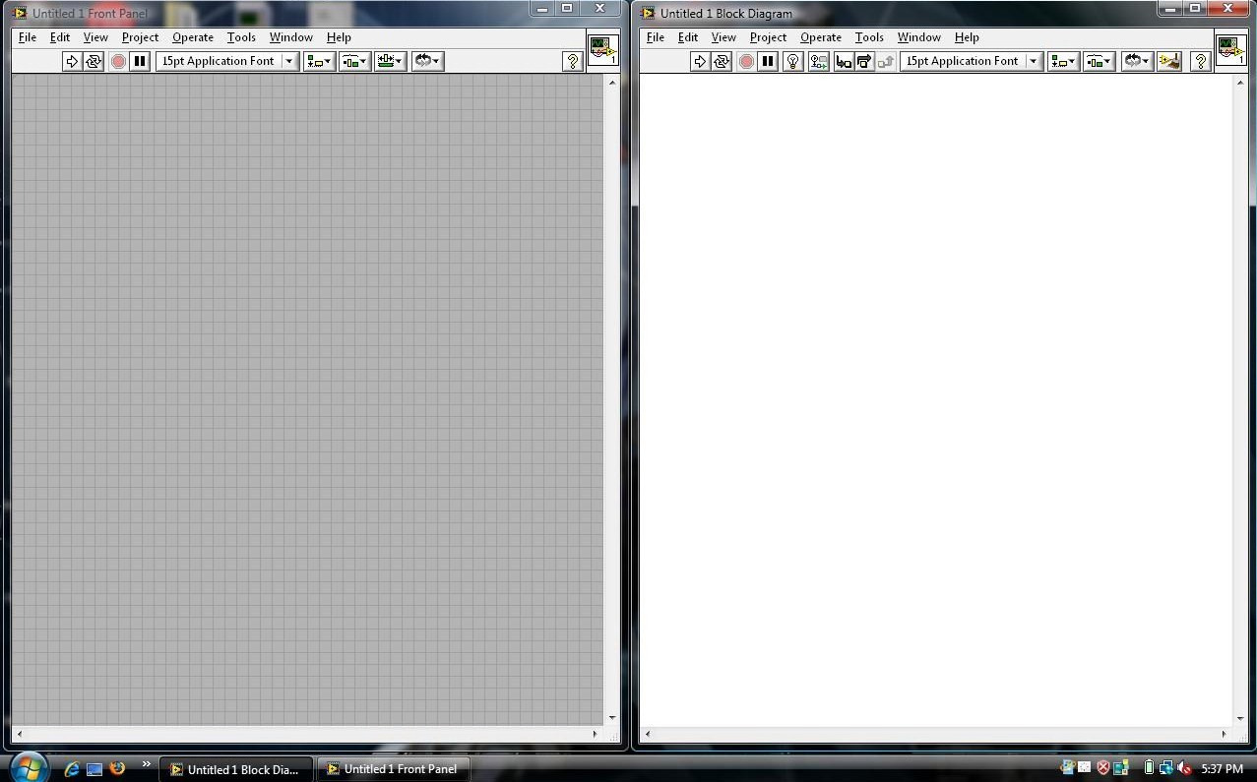
To start using LabVIEW Diff, open any VI.

Slide 24
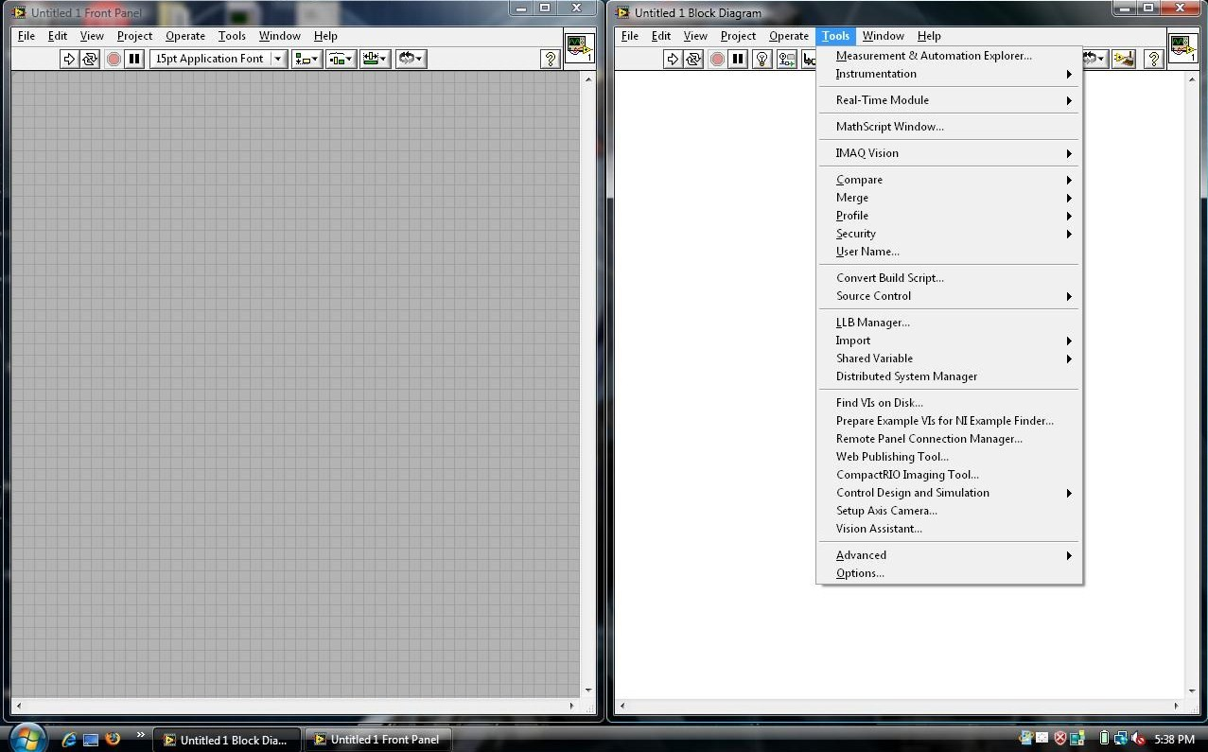
Start by pressing the Tools tab.

Slide 25
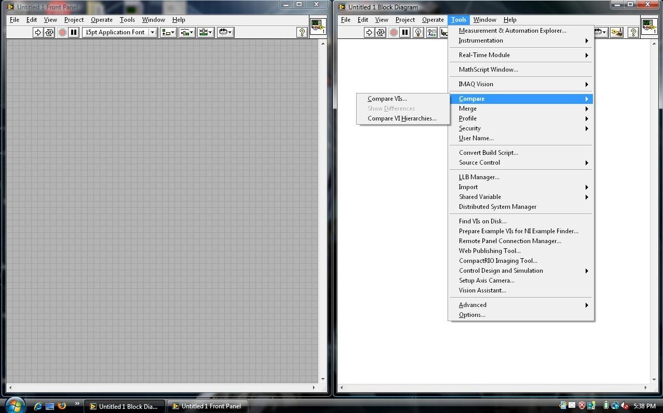
Find Compare under Tools.

Slide 26
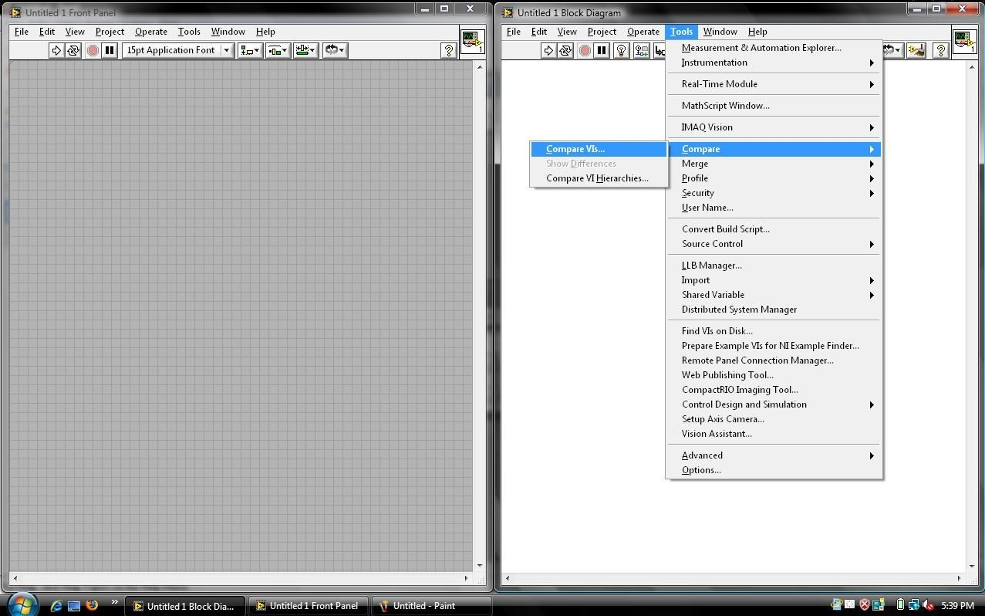
The first choice, Compare VIs, only compares VIs within a project.

Slide 27
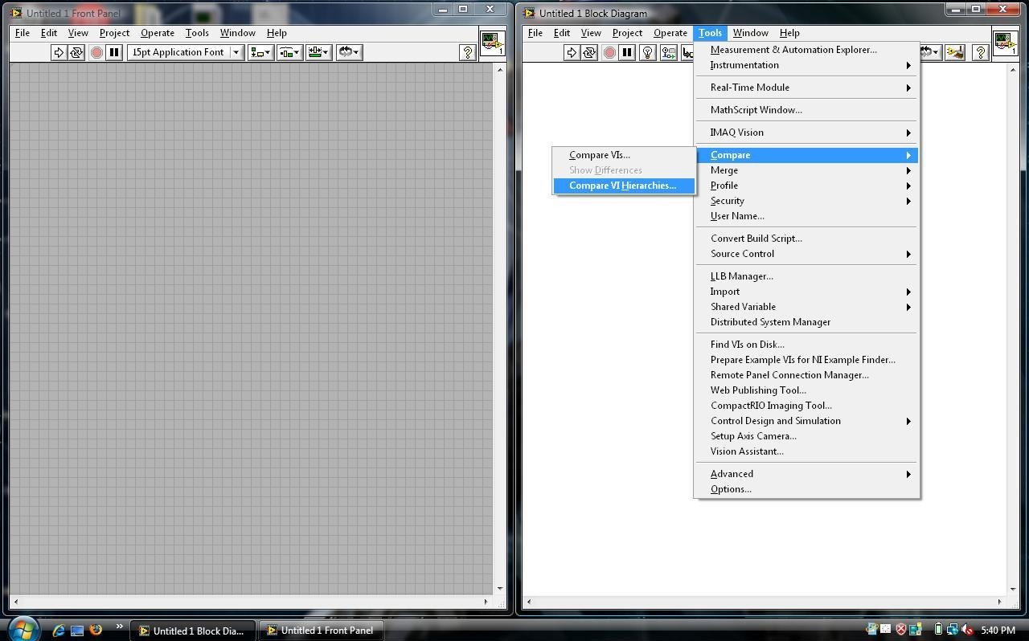
The second option, Compare VI Hierarchies, compares any two VIs.

Slide 28
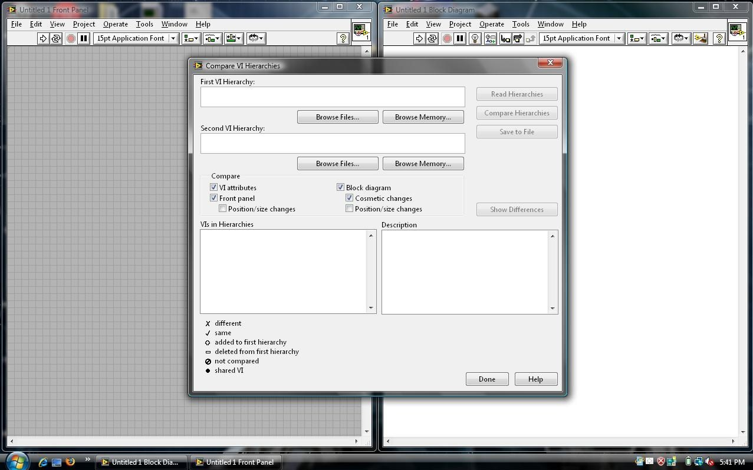
Pick what attributes of the Vis you want to compare here.
This is what you will see when you first press Compare VI Hierarchies.

Slide 29
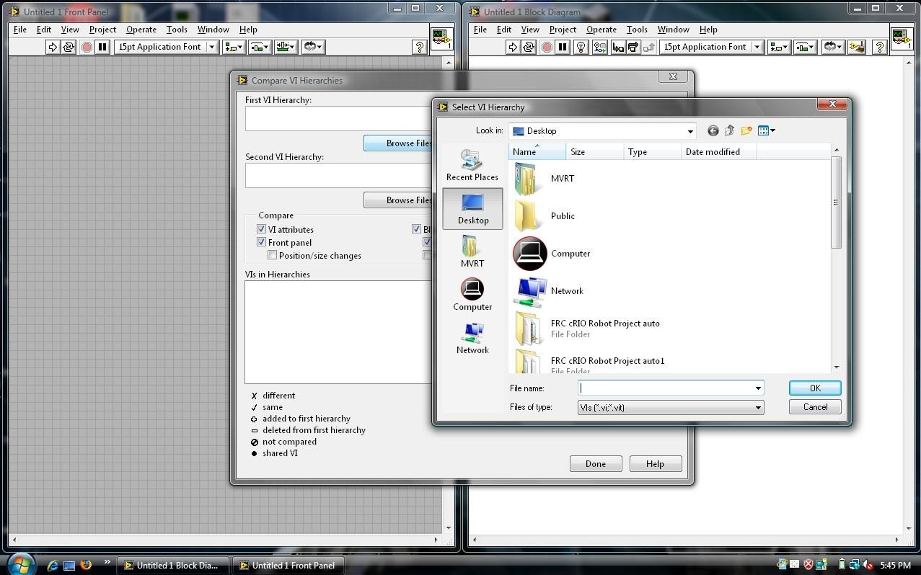
Then press Browse Files and navigate to the two VIs you want.

Slide 30
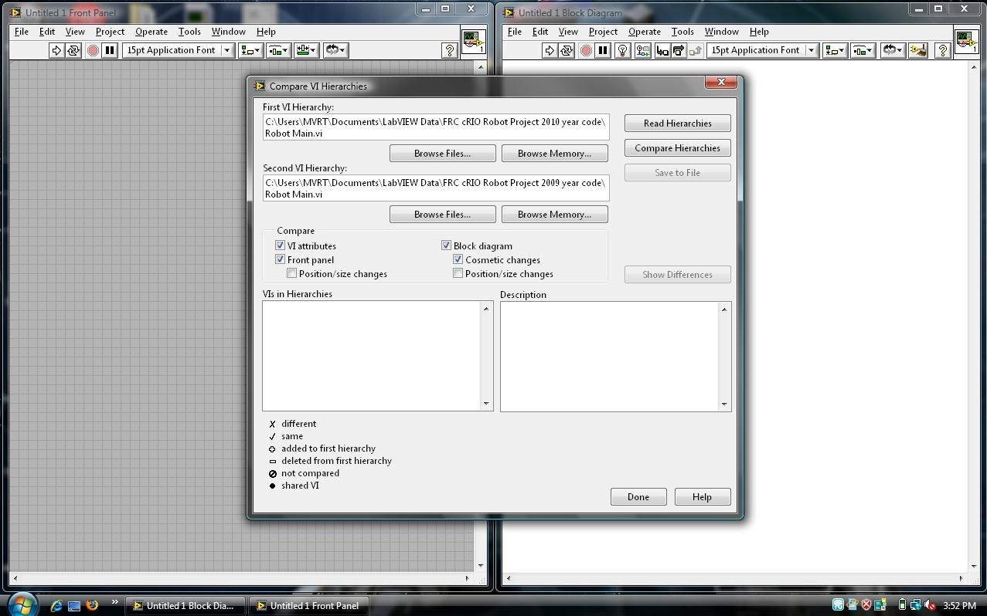
Press Compare Hierarchies.

Slide 31
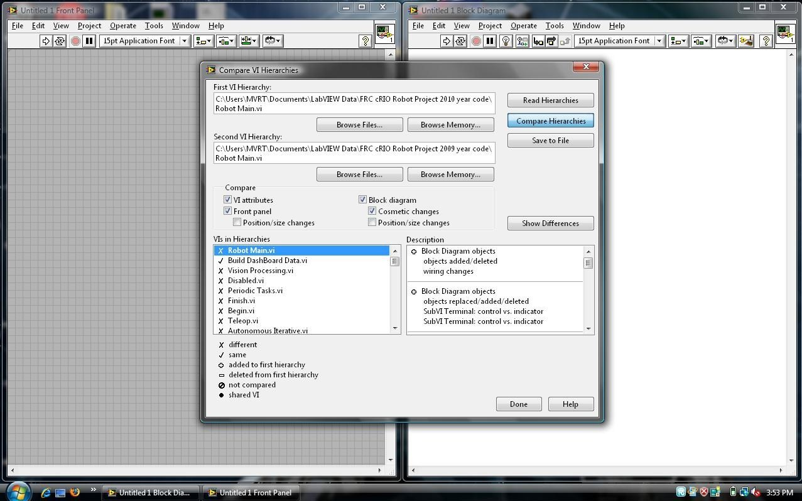
This shows the differences in writing.
This is what it looks like after pressing Compare Hierarchies
The symbols seen here show what is different.
Double click on any of the VIs under the VIs in Hierarchies

Slide 32
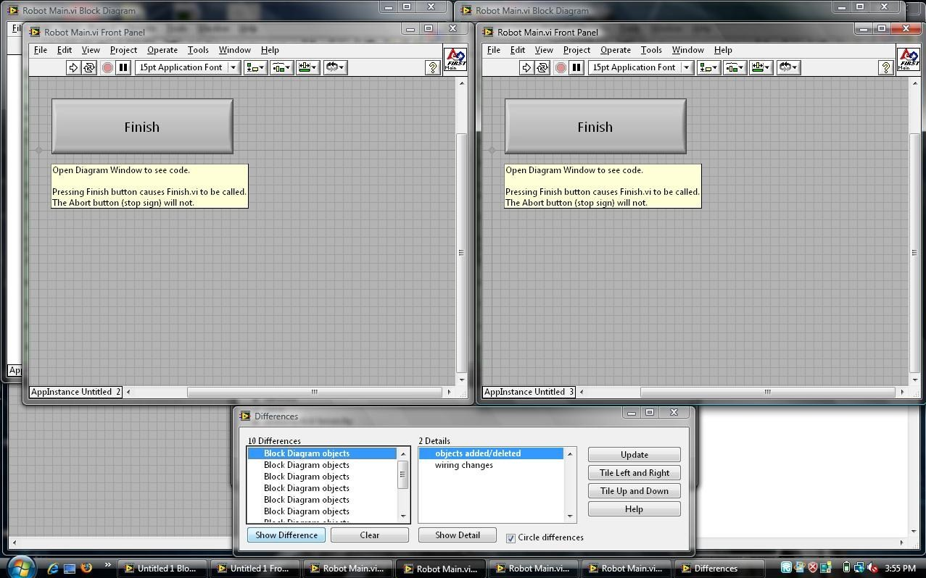
After double clicking one of the VIs, this screen appears showing the differences and details.

Slide 33
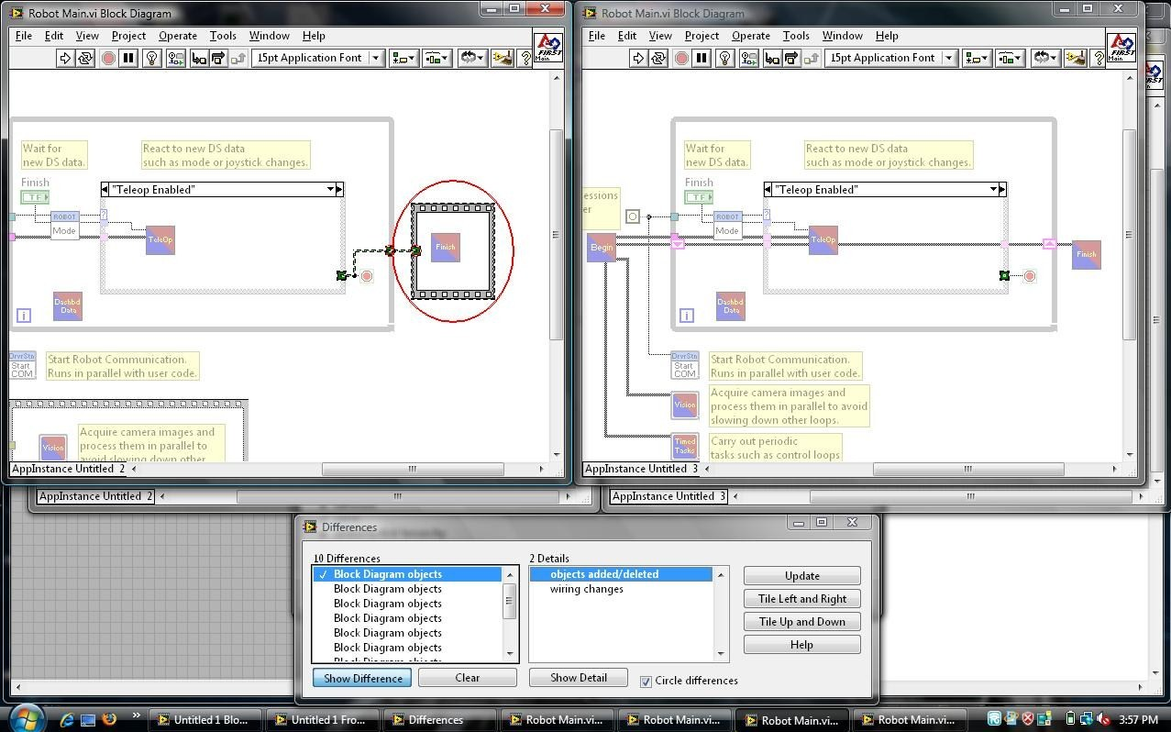
After double clicking on any of the differences, LabVIEW highlights the differences graphically.

Slide 34
LabVIEW Clean Up

Slide 35
Clean Up Feature
In LabVIEW 8.6 the clean up feature allows us to clean up the whole block diagram with the press a button.
The shortcut is Ctrl-U to clean the block diagram.
Another shortcut is the broom icon
This can be extremely useful when cleaning messy code.

Slide 36
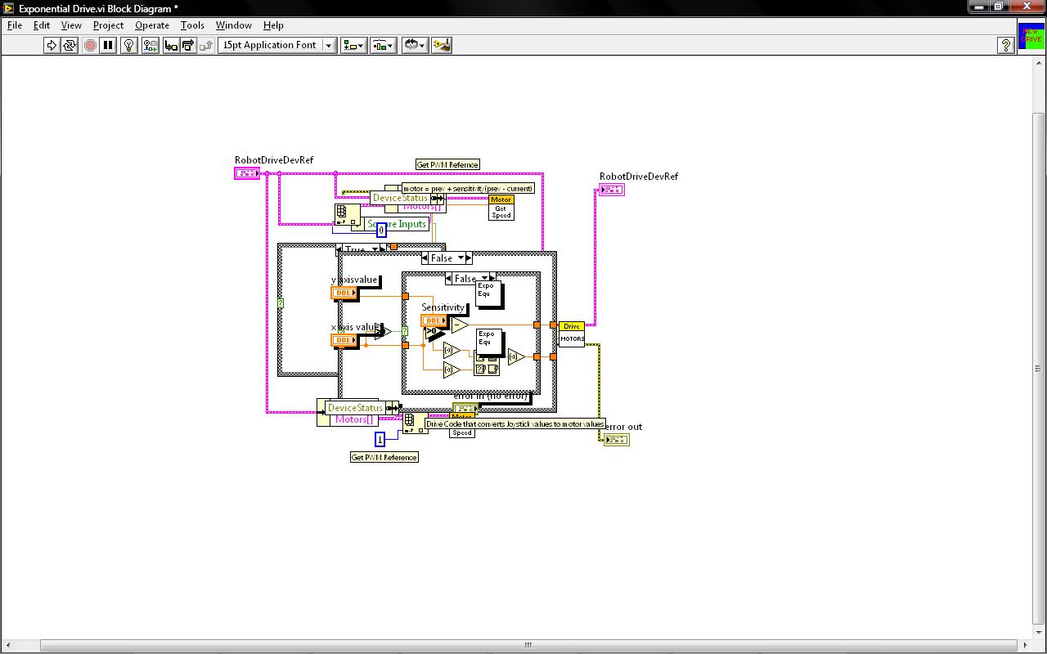
This an example of messy code.

Slide 37
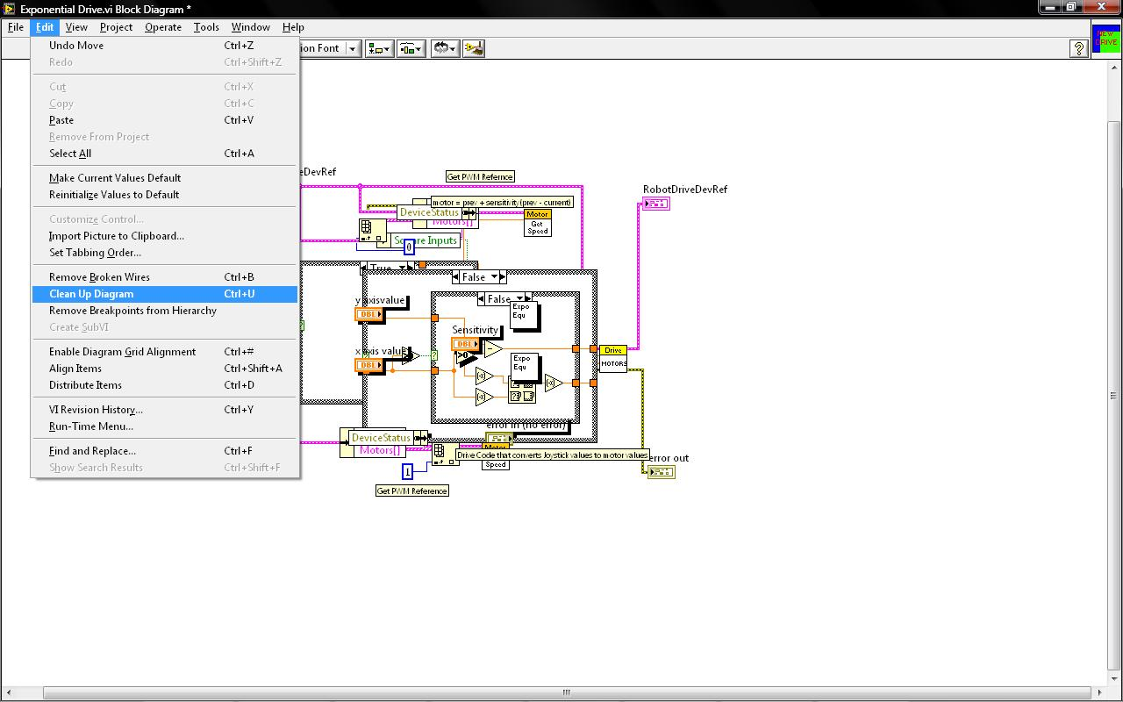
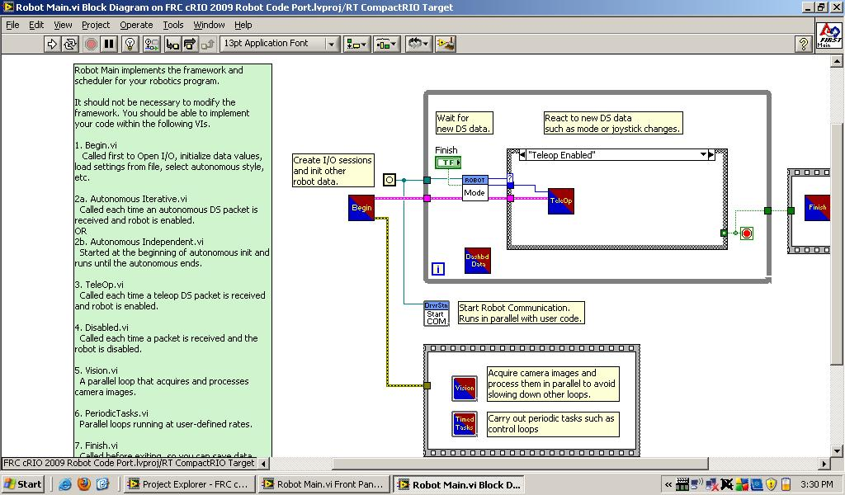
First we go to Edit tab and under it we click Clean Up Diagram.
Another way to do this is to press Ctrl-U or click the broom icon.

Slide 38
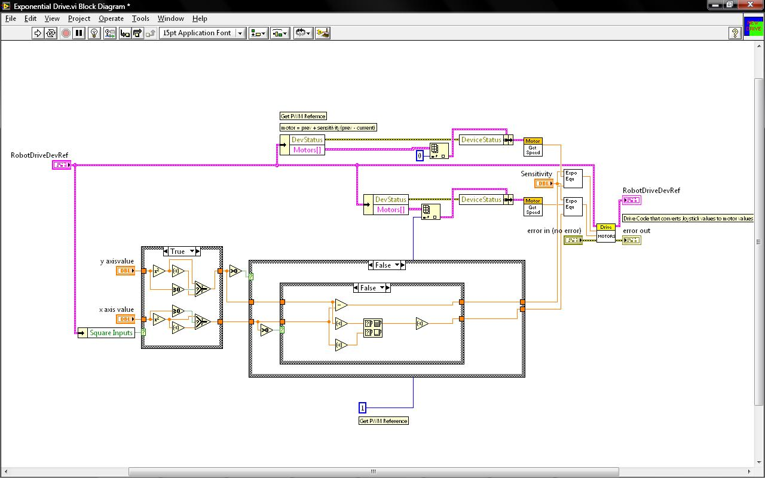
This is the cleaned up version.

Slide 39
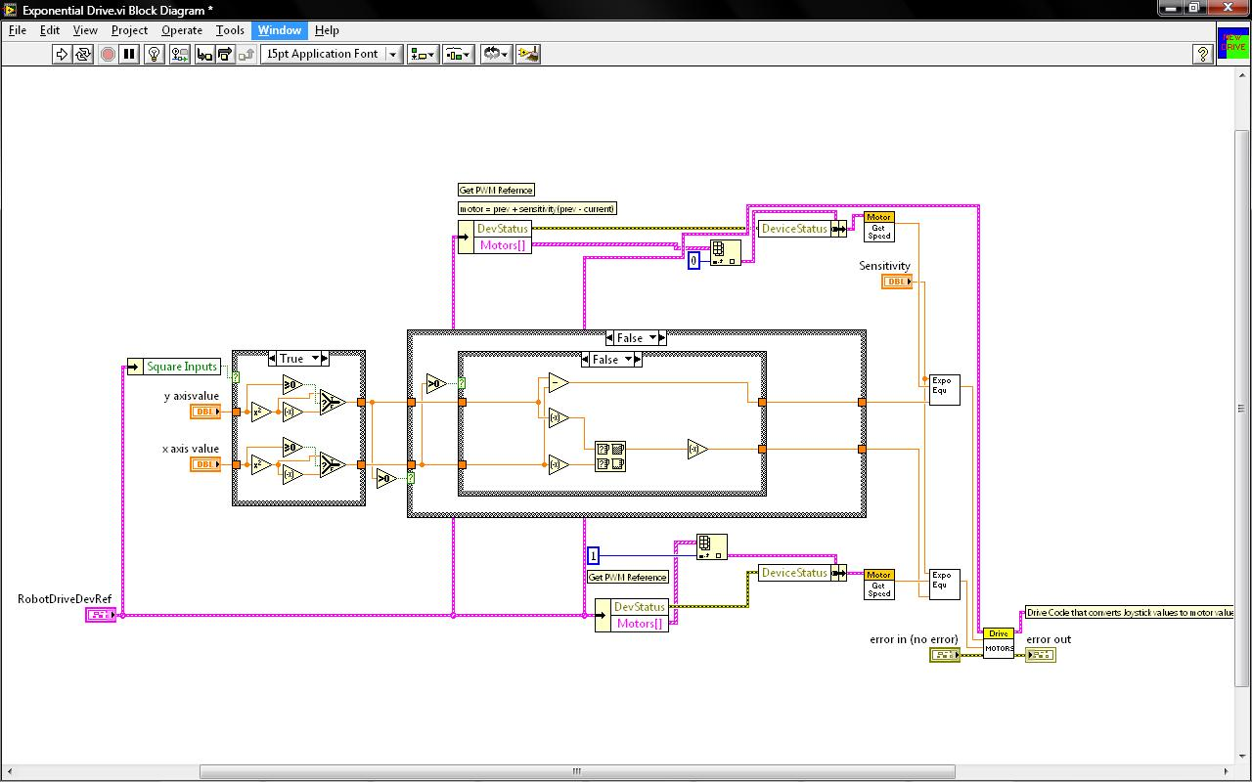
When you press clean up diagram again it shows another way it can be arranged
Take notice to the position of the comments in this code

Slide 40
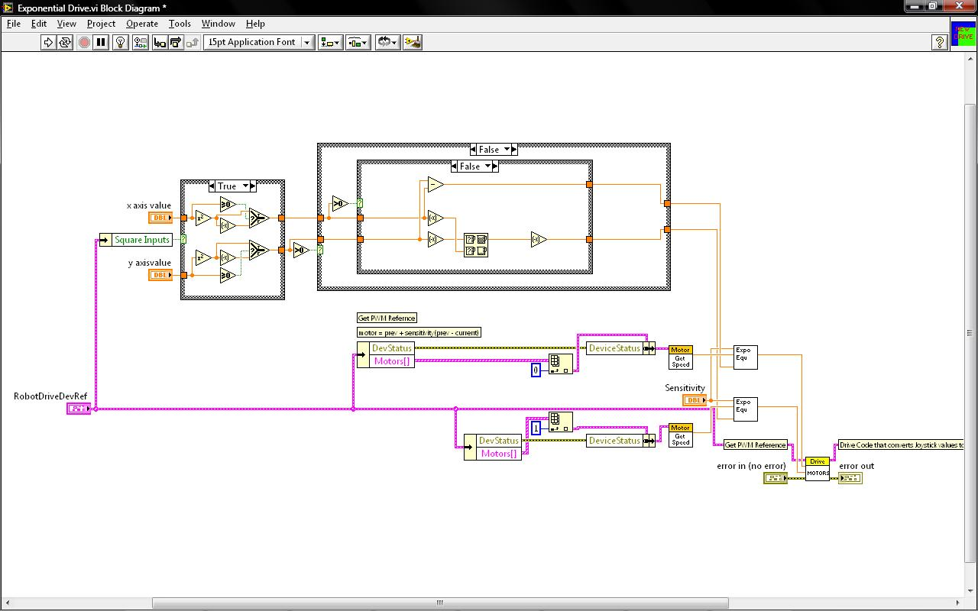
This another way it can be arranged
Comments are kept near the things they start with

Slide 41
Thanks to...
Beach Bots, Team 330
FIRST

